Slide 1

Virginia Health Benefit Exchange Advisory Committee Meeting Lou Rossiter, Chair September 25, 2025

Slide 2
Welcome

Slide 3
Agenda
Call to Order
Health Benefit Exchange Updates
Plan Year 2026: Federal Policy Changes & Open
Enrollment Preparation
Reinsurance Presentation, Bradley Marsh (BOI)
State-funded Subsidies Presentation, Erin Glossop (NCSL)
3. Other Business
4. Public Comments
5. Adjournment
3

Slide 4
Roll Call
Ex-officio Members
Acting Commissioner ​Kevin Erskine, Department of Social Services
Secretary Janet Kelly, Health and Human Resources
Director Cheryl Roberts, Department of Medical Assistance Services
Commissioner Scott White, Bureau of Insurance
Dr. Karen Shelton, State Health Commissioner
Appointed / Voting Members:​
Louis Rossiter, William & Mary, chair
Doug Gray, Virginia Association of Health Plans, vice chair
Julie Bataille
Lee Biedrycki, Benefinder
Scott N. Castro, Medical Society of Virginia
Craig Connors, Virginia Hospital & Healthcare Association
Elizabeth Cunningham, Virginia Legal Aid Society
David Cummins, Serco Inc.
Sheenu J. Kachru
Kip Piper, Health Result Group LLC

Slide 5
Plan Year 2026: Federal Policy Changes Open Enrollment Preparations

Slide 6
Road To Open Enrollment
August
September
October
November
System updates to implement new federal changes
Pre-renewal notices sent to consumers
Complete training modules for agents and assisters
Major system release to our platform
Carrier plan certification & upload
Renewals processed in staging environment
Window shopping opens October 1st
Open Enrollment Readiness Review with CMS
Renewal and eligibility notices to consumers
Execute auto renewal
Open enrollment period begins November 1st

Slide 7
Renewals
Enrollment PY24-PY26
372,087 households will be auto-renewed for PY2026.

Slide 8
Shifting Federal Regulatory and Policy Landscape
CMS 2025 Notice of Benefit and Payment Parameters
CMS Program Integrity Rule
Congressional Reconciliation Bill
CBO Estimates
CMS Guidance on Plans

Slide 9
Policy Changes Effective 2026
Provision | New Policy
Eligibility limitations | Eliminates the monthly low-income Special Enrollment Period (<150% FPL).* Rescinds eligibility for DACA recipients.* Eliminates eligibility for Premium Tax Credits for non-citizens with incomes under 100% FPL who are ineligible for Medicaid due to immigration status.
SEP limitation | Prohibits federal subsidies for income-based SEPs.**
Increased costs and payments | Increased maximum out-of-pocket limits by 15%.* Ends Advance Premium Tax Credit repayment caps.*
Expiration of expanded premium tax credits | Expected contribution towards premiums will increase for all marketplace enrollees and enrollees with incomes over 400% FPL become ineligible for PTC. **, ***
Low coverage expansion | Expands eligibility for catastrophic plans.****
Provisions Stayed by Federal Court
Coverage denials for past due premiums | Allows carriers to require past due premiums before effectuating new coverage.*
Increased verifications (2) | More income verification protocols for individuals with income mismatches.*
Limits access to PTC | Individuals who have failed to file and reconcile taxes for one year are ineligible for premium tax credits.*
Wider actuarial value ranges | Authorizes decreased value of bronze, silver, gold, and platinum plans.*
* 2025 CMS Final Rule
** H.R. 1
*** IRS Rule
****CMS Guidance

Slide 10
Policy Changes Effective 2027/2028
Provision | Implementation Date | New Policy
Shortens open enrollment periods | 1/1/2027 | Shortens the open enrollment period to Nov. 1 - Dec. 31.
Eliminates financial assistance for some lawfully present immigrants | 1/1/2027 | Includes refugees, asylees, abused spouses and children and certain victims of trafficking.
Eliminates financial assistance for individuals not meeting Medicaid work requirements | 1/1/2027 | Individuals failing to meet Medicaid work requirements are ineligible for premium tax credits.
Ends automatic re-enrollment | 1/1/2028 | Requires Marketplace enrollees’ information to be actively verified each year prior to receiving APTC.
* 2025 CMS Final Rule
** H.R. 1

Slide 11
Consumer Marketing, Outreach, & Education Critical for 2026
Brand Awareness Campaign
Shift away from affordability messaging
Focus on the importance of health coverage
Digital media, radio, social media, search
Open Enrollment Campaign
Focus on education:
Changes are coming
We are here to help
The open enrollment period is extended this year
New tactics include targeted consumer outreach, billboards, advertising on The Weather Channel app, and short-form videos.
“Life can change in an instant, be ready for anything with a Marketplace plan"

Slide 12




Examples

Slide 13
Enhanced Premium Tax Credits

Slide 14
Expanded Premium Tax Credits (ePTCs)
Premium Tax Credits
Income tax credits based on household income and health insurance premium cost
Can be paid directly to insurer to lower monthly premium cost
Originally capped at households with income <400% FPL
Expanded under The American Rescue Plan Act of 2021 (P.L. 117-2)
Available to households with incomes >400% FPL
Reduced the applicable percentage of household income in the PTC calculation for all consumers; (i.e., certain immigrants below 100% FPL)
Created $0 premium plans for <150% FPL consumers
Expire on December 31, 2025, unless Congress acts

Slide 15
Expiration of Expanded Portion of Premium Tax Credits Changes Income Contribution Percentages
Income as % of FPL | Premium Contribution Percentage 2025 | Premium Contribution Percentage 2026
<133% FPL | 0% | 2.1%
133-150% | 0% | 3.14% – 4.19%
150-200% | 0.0 - 2.0% | 4.19% – 6.6%
200-250% | 2.0 - 4.0% | 6.6% – 8.44%
250-300% | 4.0 - 6.0% | 8.44% – 9.96%
300-400% | 6.0 - 8.5% | 9.96%
400%+ | 8.5% | Unlimited

Slide 16
Cost and Enrollment Impacts of Expiring ePTCs Based on 2025 rates
Income by FPL | Total Enrolled Households | Average Household Income | 2025 Average Net Household Premium | 2026 Estimated Average Net Household Premium | 2026 Estimated Average Net Household Premium
100-133% | 31,694 | $20,362.00 | $27.00 | +$36.00 | $63.00
133-150% | 44,394 | $27,703.00 | $28.00 | +$72.00 | $100.00
150-200% | 51,571 | $34,215.00 | $59.00 | +$119.00 | $178.00
200-250% | 29,942 | $47,384.00 | $126.00 | +$182.00 | $308.00
250-300% | 19,312 | $56,324.00 | $219.00 | +$208.00 | $427.00
300-400% | 16,965 | $71,234.00 | $401.00 | +$235.00 | $636.00
>400% | 9,179 | $110,410.00 | $748.00 | +$692.00 | $1440.00

Slide 17
Projected Premium Increases by Region
 | 2025 Total Enrollees | 2026 Projected Premium Increase
Henrico County
< 400% FPL | 12,879 | $76 - $87
> 400% FPL | 845 | $644 - $739
Virginia Beach City
< 400% FPL | 14,788 | $63 - $73
> 400% FPL | 1,039 | $628 - $719
Fairfax County
< 400% FPL | 48,506 | $90 - $103
> 400% FPL | 2,552 | $671 - $769
Roanoke County
< 400% FPL | 3,302 | $90 - $103
> 400% FPL | 350 | $727 - $834
These counties have high enrollment of Virginians, and particularly high enrollment at 400% FPL and above.

Slide 18
Impact of Expiring ePTCs: Consumers At Risk
Marketplace enrollment increased the most at the lowest and highest income levels of eligibility since ePTCs became available in 2021.
Income | Enrollment Increase by Household | Enrollment Increase as Percentage
100-150% FPL | 45,109 | 82%
151-200% FPL | 13,146 | 21%
201-250% FPL | 3,463 | 7%
251-300% FPL | 5,271 | 17%
301-400% FPL | 2,923 | 9%
400%FPL+ | 42,458 | 419%

Slide 19
Questions?

Slide 20
Commonwealth Health Reinsurance Program (CHRP)
Bradley Marsh, Policy Advisor, Bureau of Insurance
September 24, 2025

Slide 21
Status for CHRP Benefit Year 2024 (BY2024)
May 2025 BOI received final BY2024 claims data from CMS
June – August 2025 BOI validated claims data and determined funding sufficiency
April 30, 2025
All carriers submitted signed attestations of compliance with claims data reporting requirements
September 30, 2025 Deadline to notify carriers of payment amounts
November 15, 2025 BY2024 CHRP payments due

Slide 22
Timeline for CHRP BY2026
January – March 2025 Carriers developed individual market offerings and rates
May 1, 2025 SCC set payment parameters
Mid-May 2025 Carriers submitted rate filings
October 18, 2025 Rate increase notice deadline
April 10, 2025
BOI contract actuary provided program cost estimates for selected scenarios
August 2025 Rates published for on-exchange plans
Mid-October 2025 CMS requires final rates for off-exchange plans
November 15, 2027 BY2026 CHRP payments due
January 1 – December 31, 2026 BY2026 coverage in effect

Slide 23
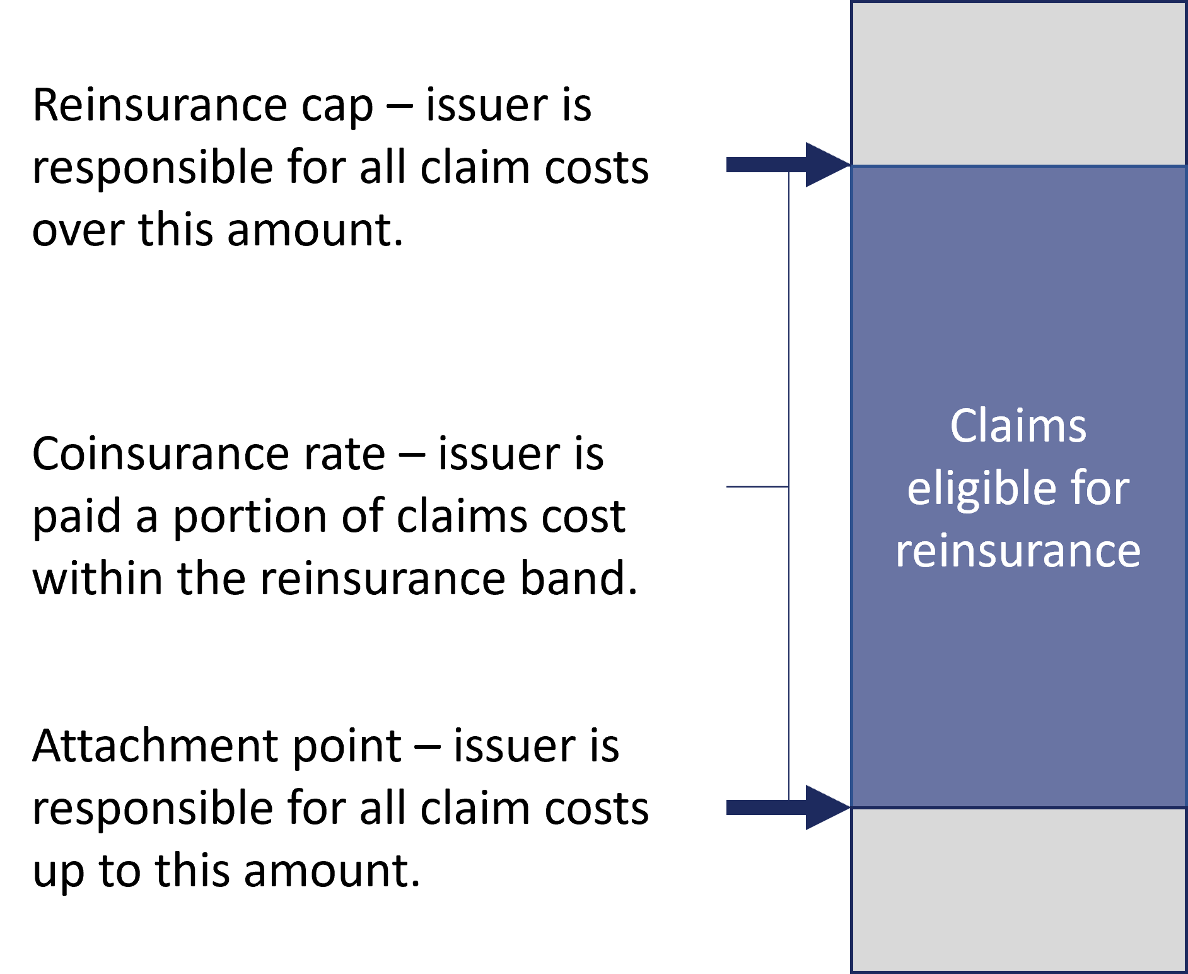
How CHRP Works
$170,000
These amounts are the payment parameters for total annual medical expenditures on any covered individual for BY2026.
Maximum CHRP payment for a covered individual in BY2026 is $81,250.
$170,000 - $45,000 = $125,000
$125,000 x 65% = $81,250
Coinsurance rate = 65%
$45,000

Slide 24
CHRP Payment Parameters BY2023-BY2026
 | BY2023 | BY2024 | BY2025 | BY2026
Attachment point | $40,000 | $45,000 | $45,000 | $45,000
Reinsurance cap | $155,000 | $175,000 | $175,000 | $170,000
Coinsurance | 70% | 70% | 70% | 65%
Targeted premium reduction | 15% | 15% | 15% | 15%
Actual average premium reduction from reinsurance | 17.30% | 16.40% | 14.80% | 16.40%*
BOI’s contract actuary annually models the CHRP payment parameters to achieve the target premium reduction for that BY.
*BY 2026 premium reduction calculated prior to lower actuarial value plans being disallowed.

Slide 25
CHRP Payments & Funding
(in millions) | BY2023 (SFY2025) | BY2024 (SFY2026) | Estimated BY2025 (SFY2027) | Estimated BY 2026* (SFY2028)
CHRP payments | $323.37 | $368.18 | $429.70 | $404.50
BY Federal pass-through funding award | $331.88 | $481.94 | $450.27 | $308.4
Annual pass-through funding balance after payment | $8.51 | $113.76 | $20.57 | - $96.10
Cumulative pass-through funding balance after payment | $8.51 | $122.27 | $142.84 | $46.74
Federal “pass-through” funding is based on projected federal savings from reduced premium tax credits (PTCs) due to lower health insurance premiums.
Estimates of program costs are developed 8 – 10 months prior to a BY and more than 2 years prior to claims being finalized and paid.
Differences between the model and actual enrollment, premium impact, and claims experience can cause program costs to differ substantially from these estimates.
*BY2026 estimates were calculated in April 2025, prior to federal budget and policy changes.

Slide 26
Revised estimates of CHRP program cost
Current estimates assume that enhancements to premium tax credits (PTCs) from the 2022 Inflation Reduction Act will expire prior to BY2026.
SCC BOI is working with its contract actuarial firm for an updated model of federal pass-through funding and state share funding for BY2026, incorporating the most recent federal budget developments.
Specifically, this analysis will incorporate actual BY2026 premium rates as well as three new federal policy changes:
Removal of the monthly Special Enrollment Period (SEP) for individuals eligible for premium tax credits (PTCs) with household incomes at or below 150% of the of the Federal Poverty Line (FPL);
Changes to the Premium Adjustment Percentage Index calculation methodology;
Removal of eligibility for subsidies for lawfully-present immigrants with incomes under 100% of the FPL.
BOI plans to present updated cost estimates at the October 6, 2025 HIRC meeting.

Slide 27
Impacts of potential federal changes on CHRP
If PTC enhancements expire, people over 400% FPL will lose subsidies entirely and people below 400% FPL will receive smaller subsidies.
Fewer or smaller PTCs means less federal savings from reinsurance and could reduce federal pass-through funding.
Households over 400% of FPL have been incentivized by EPTCs to purchase on-exchange, increasing federal pass-through funding and decreasing the anticipated state share of costs.
Healthy people are less inclined to purchase health insurance if it becomes expensive.
Sicker individuals – who are more likely to breach the attachment point with their annual claims costs—are more likely to enroll or re-enroll versus healthier people.
A less healthy population is a riskier population to insure, which the rate filings will take into account, likely increasing premiums even with the specified premium reduction target from the Commonwealth Health Reinsurance Program.
EPTC expiration will reduce federal pass-through funding.
Fewer individuals eligible for PTCs, and smaller PTC amounts for those eligible will reduce estimated federal savings.
Reduced federal savings mean that federal pass-through funding may cover a smaller proportion of costs for the Commonwealth Health Reinsurance Program in SFY2028.

Slide 28
Upcoming CHRP policy decision points
How much funding to appropriate from the general fund in the upcoming biennium for BY2025 (paid in State Fiscal year 2027) and BY2026 (paid in State Fiscal Year 2028).
The approved State Innovation Waiver requires that: “sufficient funds are available on an annual basis for the waiver to operate”; therefore, the Commonwealth has an obligation to appropriate sufficient funds as described in the approved waiver plan.
Revised estimates of BY2026 program costs will help determine whether Virginia has enough excess federal pass-through funding from prior years to cover all program costs.
681930

Slide 29
Upcoming CHRP policy decision points (cont.)
What premium reduction target to set for BY2027
If the General Assembly does not specify a target in the 2026 Appropriations Act, it will default to 15%.
Under current law, the maximum targeted premium reduction is 20%, but this could be amended through legislation or overridden with the Appropriations Act.
If legislators would like BY2027 cost estimates to include scenarios that exceed the 20% threshold, SCC BOI needs to provide guidance to our contract actuary by December 2025. SCC BOI has requested that legislators provide direction on this matter by November 30, 2025.
CHRP is presently the single largest state policy lever to reduce premiums in the individual market, particularly for those who are ineligible to receive PTCs

Slide 30
Upcoming CHRP policy decision points (cont.)
(1) Whether to apply for an extension of the State Innovation Waiver, (2) how long of an extension should be requested, and (3) whether changes to the waiver should be requested contemporaneous with the extension request
The Centers for Medicare and Medicaid Services must be notified of an extension request no later than December 31, 2026.
Because the original waiver application was mandated by legislation and all subsequent state share funding have been included in the Appropriations Act, SCC BOI would require direction through approved 2026 General Assembly legislation to file this extension.
SCC BOI is available to provide technical drafting assistance on enabling legislation.

Slide 31
Questions?

Slide 32

Marketplace Coverage Affordability: A Look at State-Based Marketplace Subsidy Programs
Erin Glossop, NCSL September 25, 2025

Slide 33


How NCSL Serves State Legislatures
The National Conference of State Legislatures (NCSL) is the bipartisan organization serving legislators and legislative staff in America’s 50 states, D.C. and territories. With a strong belief in the importance of the legislative institution, NCSL knows when states are strong, our nation is strong.
Source: NCSL
POLICY RESEARCH
CONNECTIONS
TRAINING
STATE VOICE IN D.C.
MEETINGS
NCSL provides trusted, nonpartisan policy research and analysis
NCSL links legislators and staff with each other and with experts
NCSL delivers training tailored specifically for legislators and staff
NCSL represents and advocates on behalf of states on Capitol Hill
NCSL meetings facilitate information exchange and policy discussions

Slide 34
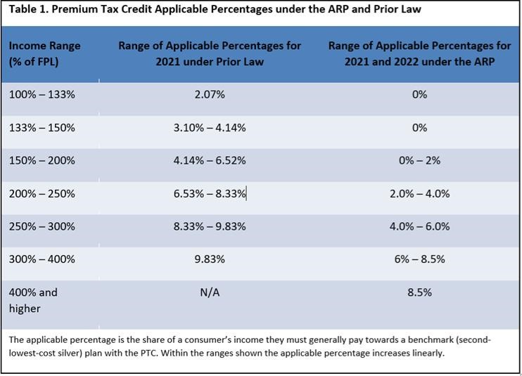
Health Insurance Marketplace Premium Tax Credits
The Affordable Care Act (ACA) established premium tax credits for individuals purchasing insurance on the ACA marketplace.
The American Rescue Plan Act (ARPA) expanded premium tax credit eligibility and made them more generous for all income earners.
Before ARPA, premium tax credits were only available for people with incomes between 100% and 400% of the federal poverty level (FPL).
ARPA extended eligibility to people with incomes over 400% FPL, eliminating the ACA’s “subsidy cliff.”
It capped the percentage of income paid toward their premiums at 8.5% for those making more than 400% FPL —those with incomes between 100% and 150% would pay no premiums.
These enhanced premium tax credits will expire at the end of 2025 if not renewed by Congress.
POLICY RESEARCH
CONNECTIONS
TRAINING
NCSL provides trusted, nonpartisan policy research and analysis
NCSL links legislators and staff with each other and with experts
NCSL delivers training tailored specifically for legislators and staff
Source: USC-Brookings Schaeffer Initiative for Health Policy

Slide 35
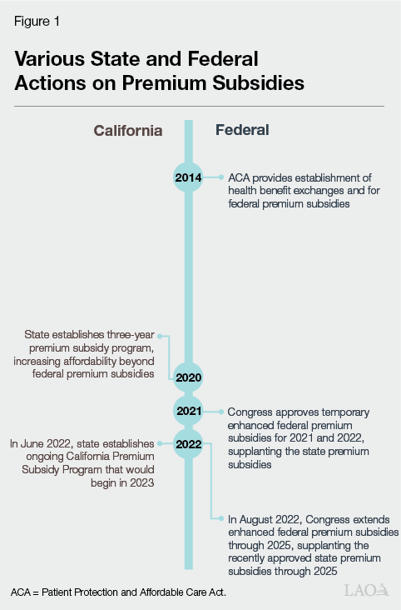

State Actions
State Actions
State Example: California
What: California began its subsidy program in 2020. Discontinued it in 2022. Implemented a new enhanced cost-sharing reduction (CSR) program in 2024.
Authorizing Authority: State budget by the California State Assembly.
Funding Mechanism: Revenue from penalties for California's individual health insurance mandate.
Who: Eliminates deductibles in certain plans for individuals at or below 250% FPL. Expanded eligibility in 2025, allowing those with incomes above 200% FPL to enroll in a plan with no deductibles and reduced out-of-pocket costs.
What's Next: Should Congress extend the enhanced premium tax credits, California's program will maintain the current levels of benefits.
If not, California has allocated $190 million for 2026 for subsidies up to 150% FPL. Program would also provide some additional assistance up to 165% FPL.
Source: California Legislative Analyst's Office
Notes:
Health Care Affordability Reserve Fund
https://shvs.org/state-health-updates-145/
A premium subsidy (or premium tax credit) lowers your monthly health insurance bill, while a cost-sharing subsidy (or cost-sharing reduction) lowers the out-of-pocket costs you pay when you get healthcare services like doctor visits or hospital stays.
California originally began its subsidy program in 2020, appropriating funding to provide subsidies to consumers making up to 600% FPL.
The 2019-2020 Budget included $428.6 million General Fund in 2019-20, $479.8 million in 2020-21, and $547.2 million in 2021-22 to provide subsidies to qualified individuals between 200 and 600 percent of the federal poverty level and individuals at or below 138 percent of the federal poverty level.
The Budget also included statutory changes to allow Covered California to implement the program, which was scheduled to sunset January 1, 2023.
The Budget included statutory changes to implement a state individual mandate that requires individuals to obtain comprehensive health care coverage or pay a penalty, based on the original provisions of the Affordable Care Act. These penalty revenues were used to support increased subsidies on the exchange.
However, the passage of enhanced premium tax credits as part of the American Rescue Plan made this program obsolete and it was discontinued in 2022.
California implemented a new state-funded enhanced cost-sharing reduction (CSR) program in 2024 after the legislature passed $82.5 million in funding.
This program is funded through revenue from penalties for California's individual health insurance mandate, which passed as part of S.B. 78 in 2019.
The program eliminates deductibles in all three Silver CSR plans for individuals at or below 250% FPL.
In 2025, the California legislature appropriated an additional $165 million to expand eligibility for the program, allowing those with incomes above 200% FPL to enroll in an Enhanced Silver 73 plan with no deductibles and reduced out-of-pocket costs.
Should Congress extend the enhanced premium tax credits, California's program will maintain the current levels of benefits.
If the tax credits are not extended, California has allocated $190 million for 2026 for subsidies for individuals earning up to 150% FPL. The program would also provide some additional assistance for those earning up to 165% FPL.

Slide 36

State Actions
State Actions
State Example: Colorado
What: In 2022, Colorado began offering cost-sharing subsidies on its marketplace.
Authorizing Authority: State Legislation: SB 215 (2020)
Funding Mechanism: Assessment fee on health insurers. Passed additional funding in August 2025 special session through sale of tax credits to insurance companies and C corporations.
Who: Cost-sharing subsidies for enrollees with incomes 150-200% FPL. Also provided subsidies for those up to 250% FPL in 2024, though this expansion of eligibility dropped back to 200% in 2025.
What's Next: Beginning in 2026, Colorado will transition from a cost-sharing subsidy to an extra premium subsidy.
Notes:
C.R.S. 10-16-1205 – Health insurance affordability fee
Colorado enacted legislation in 2020 creating the Health Insurance Affordability Enterprise to provide premium and cost-sharing subsidies through an assessment fee on health insurers.
The assessment fee was previously included in the ACA, but federal lawmakers permanently repealed it in 2019.
Colorado began providing cost-sharing subsidies for marketplace enrollees with incomes from 150-200% FPL in 2022.
The state also provided premium tax credits for enrollees with incomes up to 250% FPL who were not eligible for federal premium tax credits beginning in 2023, though this expansion has expired as of 2025.
Beginning in 2026, Colorado will transition from a cost-sharing subsidy to an extra premium subsidy.
Enrollees with incomes at or below 200% FPL will be eligible to receive $50 per member per month for the first household enrollee in additional to any federal subsidies and $18 per member per month for all subsequent enrollees.
Colorado held a special legislative session in August and enacted legislation appropriating additional funding for the state's subsidy program should the enhanced premium tax credits be allowed to expire at the end of the year, funded through the sale of tax credits to insurance companies and C corporations.
The state enacted H.B. 6, which appropriated:
Up to $50 million to the reinsurance program
Up to $50 million to carriers for state-based insurance subsidies
Up to $5 million for other programs administered or funded by the Health Insurance Affordability Enterprise.

Slide 37

State Actions
State Actions
State Example: Maryland
What: Maryland began offering subsidies to young adults in 2022. Passed expanded subsidy program in 2025.
Authorizing Authority: State Legislation: HB 0780 (2021)
Funding Mechanism: Dollars from the State Reinsurance Program, plus unspent funds from prior years and a 1% state premium tax.
Who: Young adults ages 18 to 34 with incomes between 138% and 400% FPL, before it was expanded up to age 37 (in 2025).
What's Next: Legislature passed legislation in May creating a State-Based Health Insurance Subsidies Program not exclusive to young adults to mitigate an expected expiration of the enhanced premium tax credits, funded through the same mechanism as the pilot program.
If the enhanced premium tax credits are extended, the bill will not go into effect.
Notes:
Maryland's legislature passed legislation in 2021 creating a State-Based Young Adult Health Insurance Subsidies Pilot Program administered by the Maryland Health Benefit Exchange.
The pilot program was funded through dollars from the State Reinsurance Program, plus unspent funds from prior years and a 1% state premium tax.
Young adults ages 18 to 34 with incomes between 138% and 400% FPL were originally eligible for the program before it was expanded up to age 37.
The pilot was originally capped at $20 million annually and set to terminate at the end of fiscal year 2024. This was extended by the legislature in 2023 to expire at the end of fiscal year 2026.
Maryland Health Benefit Exchange issued a report in 2024 on the impact of the Young Adult Subsidies Pilot program, finding that it resulted in "increased young adult enrollment, a reduction in young adult uninsured rates, improved morbidity in the individual market, and increased federal funding for the reinsurance program."
The report also found that approximately half of the total cost of the program was offset by increases in federal pass-through funding brought in by young adult enrollees.
The legislature passed legislation in May making the pilot program permanent and authorizing, rather than requiring, the Maryland Health Benefit Exchange to implement it.
The legislature also passed legislation in May creating a State-Based Health Insurance Subsidies Program not exclusive to young adults to mitigate an expected expiration of the enhanced premium tax credits, funded through the same mechanism as the pilot program.
If the enhanced premium tax credits are extended, the bill will not go into effect.

Slide 38

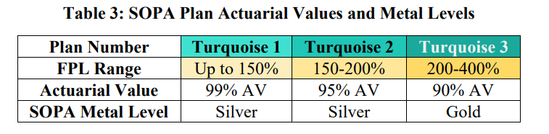
State Actions
State Actions
State Example: New Mexico
What: New Mexico began providing premium and cost-sharing subsidies in 2023.
Authorizing Authority: State Legislation SB 317 (2021)
Funding Mechanism: Assessment fee on health insurers
Who: Individuals with incomes up to 400% FPL may purchase Turquoise 3 plans. Native Americans with incomes up to 300% FPL are given access to a $0 option for each insurer in their rating area.
What's Next: The Office of the Superintendent of Insurance announced in August that even if the enhanced premium tax credits expire, New Mexico's subsidy program will cover the loss for households with incomes under 400% FPL.
Source: New Mexico Office of Superintendent of Insurance & Health Care Authority
Notes:
In 2021, the legislature passed S.B. 317, creating the Health Care Affordability Fund (HCAF) and mandating the creation of programs to lower health insurance costs.
This was funded with revenues from an assessment fee on health insurers, which the legislation raised from 1% to 3.75%.
With this funding, New Mexico began providing premium and cost-sharing subsidies through its Marketplace Affordability Program in 2023.
Plans with cost-sharing reductions are known as 'turquoise' plans on New Mexico's health insurance marketplace.
In 2025, the state expanded eligibility for the subsidy program, allowing individuals with incomes up to 400% FPL to purchase Turquoise 3 plans.
New Mexico also offers an additional premium assistance program for Native Americans with incomes up to 300% FPL, who are given access to a $0 option for each insurer in their rating area.

Slide 39

State Actions
State Actions
State Example: New York
What: New York began offering cost-sharing subsidies in 2025.
Authorizing Authority: Section 1332 Waiver.
Funding Mechanism: Federal pass-through funding
Who: Marketplace enrollees with diabetes, pregnant enrollees (or up to 12-months postpartum) and individuals and families with incomes up to 400% FPL.
What's Next: Due to changes in HR 1 that modify premium tax credit eligibility, New York expects to receive substantially less federal funding.
On September 10, the state requested to terminate its waiver as currently approved.
It also requested to reactivate its currently suspended Basic Health Program.
Notes:
New York received approval for its Section 1332 Waiver under the Affordable Care Act in September 2024. It was set to be active January 1, 2025 through December 31, 2028.
The waiver expanded eligibility for the Essential Plan (EP), similar to the state's Basic Health Program (BHP), for individuals with incomes up to 250% FPL.
As a result, the state received federal pass-through funding due to the "elimination of spending on premium tax credits in the individual market for certain individuals with estimated household incomes 200 to 250% of FPL and based on the elimination of federal spending on BHP payments to the extent the associated savings correspond to premium tax credits for individuals who would have otherwise enrolled in qualified health plans (QHP)."
Utilizing the federal pass-through funding, the state provided cost-sharing subsidies for Marketplace enrollees with diabetes, enrollees who were pregnant or up to 12-months postpartum and individuals and families with incomes up to 400% FPL.
However, due to changes in H.R. 1 that modify premium tax credit eligibility, New York expects to receive substantially less federal funding and on September 10 requested to terminate its waiver as currently approved. It also requested to reactivate its currently suspended Basic Health Program.

Slide 40

State Actions
State Actions
State Example: Washington
What: Washington began offering premium and cost-sharing subsides in 2023.
Authorizing Authority: State Legislation: SB 5733 (2021)
Funding Mechanism: Appropriation out of the state's general revenue fund from the State Health Care Affordability Account.
Who: Individuals with incomes up to 250% FPL who enroll in a silver or gold Cascade Care plan.
What's Next: The Washington Health Benefit Exchange has estimated that maintaining the same subsidy levels in 2026 will cost roughly $70 million more than is budgeted.
The state is considering a variety of approaches with the expiration of EPTCs, including lowering subsidies for customers eligible for federal advance premium tax credits.
Notes:
Washington enacted legislation in 2021 requiring the Washington Health Benefit Exchange to create a premium assistance and cost-sharing reduction program.
The program, known as Cascade Care Savings, is currently funded through an appropriation out of the state's general revenue fund of $110 million for plan years 2024 and 2025 from the State Health Care Affordability Account.
The state began providing premium and cost-sharing subsidies in 2023 for individuals with incomes up to 250% FPL if they enroll in a silver or gold Cascade Care plan.
In 2025, eligible customers receive a maximum monthly premium subsidy of $155 per member per month for customers eligible for federal tax credits and $250 per member per month for customers ineligible for federal tax credits.
Due to funding shortfalls, customers enrolling after December 18, 2024 were no longer able to apply for Cascade Care Savings for plan year 2025.
The Washington Health Benefit Exchange has estimated that maintaining the same subsidy levels in 2026 will cost roughly $70 million more than its budget.
The state is considering a variety of approaches in the face of expiring enhanced premium tax credits, including lowering subsidies for customers eligible for federal advance premium tax credits.

Slide 41

Q&A

Slide 42


Erin Glossop
Reach out anytime!
EMAIL
erin.glossop@ncsl.org
PHONE
(303) 856-1392
WEB
www.ncsl.org
Policy Specialist, Health

Slide 43
Questions?

Slide 44
Public Comments are accepted on an ongoing basis at: HBEAdvisoryCommittee@scc.virginia.gov

